Slide 1
Banking & Financial Invoice Processing
using Agentic AI (rule-based multi-agent simulation)
Problem | Solution | Architecture | Demonstration
College Project | Python + Streamlit

Slide 2
The Problem
WHY IT MATTERS
Manual invoice checking is slow and easy to get wrong
Teams cross-check fields, totals, old records and payments from separate sources before approving.
≠
Calculation errors
2×
Duplicate invoices
A wrong total slips through unnoticed
The same bill gets paid twice
₹
Payment mismatches
?
No clear trail
Amount paid differs from amount billed
Hard to explain why it was approved
IMPACT
Financial loss, delayed vendor payments and compliance risk.
CORE QUESTION
How can these checks be automated clearly, with a human keeping final control of payment?
2

Slide 3
Proposed Solution
Four specialised agents validate each invoice and give one clear status. A human still approves.
Slow manual checking
→
Automated pipeline runs all 5 checks in one click
Calculation errors
→
Exact Decimal maths verifies subtotal + tax = total
Duplicates and mismatches
→
Checks against earlier invoices and payment records
No clear trail
→
Every result has reasons plus a step-by-step audit log
Risk of auto-payment
→
Never pays; best result is “eligible for human review”
Honest scope: fixed Python rules on synthetic data. No LLM, no OCR, no database, no real payments.
3

Slide 4
System Architecture
PRESENTATION
Streamlit Dashboard (app.py)
Select invoice, click Process, view status, checks, reconciliation, audit log
↕
CONTROL
Orchestrator: process_invoice()
Runs agents in order, applies the empty-data gate, writes the audit log
AGENTS
Planner
Document
Validation
Critic
→
→
→
task list
read fields
5 checks
final status
↕
DATA
Sample invoices
Existing invoices
Payment records
6 synthetic
duplicate check
reconciliation
4

Slide 5
Workflow: How an Invoice Flows
1
2
3
4
5
Planner
Document
Gate
Validation
Critic
→
→
→
→
Creates 5-step plan
Reads 6 fields
Nothing read? Stop: INCOMPLETE
Runs 5 checks
Decides final status
Output: final status + reasons + 5 check results + reconciliation + audit log
5

Slide 6
The Four Agents
Agent | Role | Output
Planner | Manager: decides the steps | List of 5 tasks
Document | Data-entry clerk: reads invoice | 6 extracted fields
Validation | Checker: runs 5 checks | PASS / FAIL / SKIPPED per check
Critic | Judge: reviews all results | Status + reasons
6

Slide 7
The 5 Validation Checks
Required fields are present
Total = subtotal + tax (exact Decimal maths)
Invoice number is not a duplicate
A payment record exists
Payment amount equals invoice total
Each check returns
PASS, FAIL or SKIPPED
7

Slide 8
Critic Agent: Decision Logic
VERIFIED
All 5 checks passed. A human still approves.
FLAGGED
A rule broke: wrong total, duplicate, or payment mismatch.
INCOMPLETE
Information missing: blank field, bad number, no payment record.
Missing payment is not treated as fraud. A failed check can never be VERIFIED.
8

Slide 9
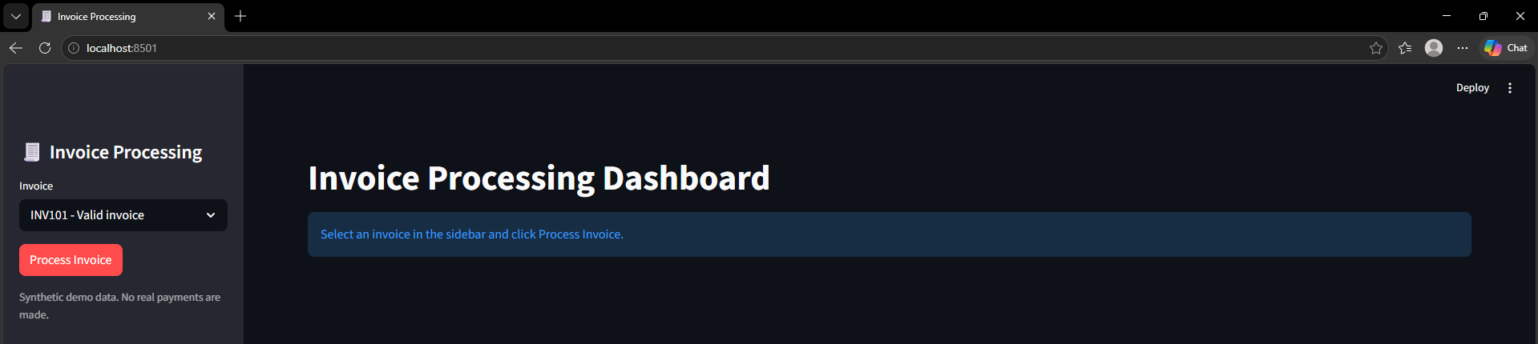
Demo: Launch the Dashboard
1
Start the app
2
Open the browser
3
Choose and process
Run streamlit run app.py in the terminal
The dashboard loads at localhost:8501
Pick an invoice in the sidebar, then click Process Invoice
9
Notes:
Run: streamlit run app.py, then open localhost:8501. Pick an invoice in the sidebar and click Process Invoice.

Slide 10
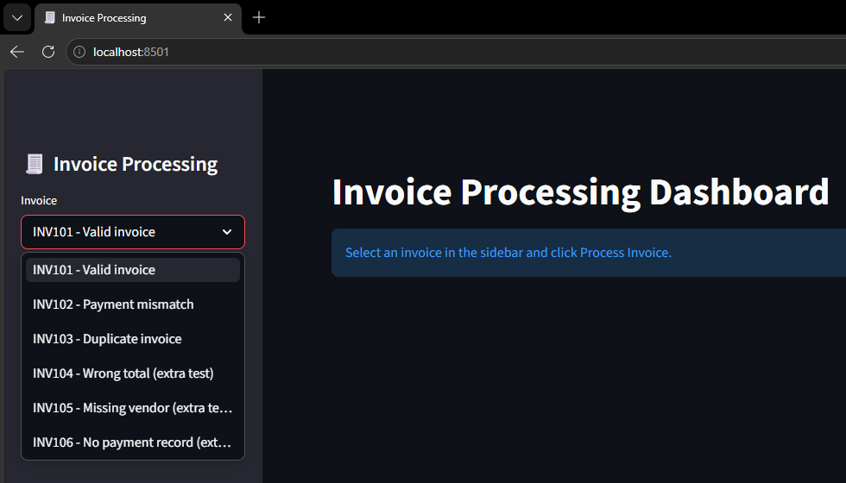
Demo: Select an Invoice
Six synthetic test invoices
INV101
Valid invoice
INV102
Payment mismatch
INV103
Duplicate invoice
INV104
Wrong total (extra test)
INV105
Missing vendor (extra test)
INV106
No payment record (extra test)
10

Slide 11
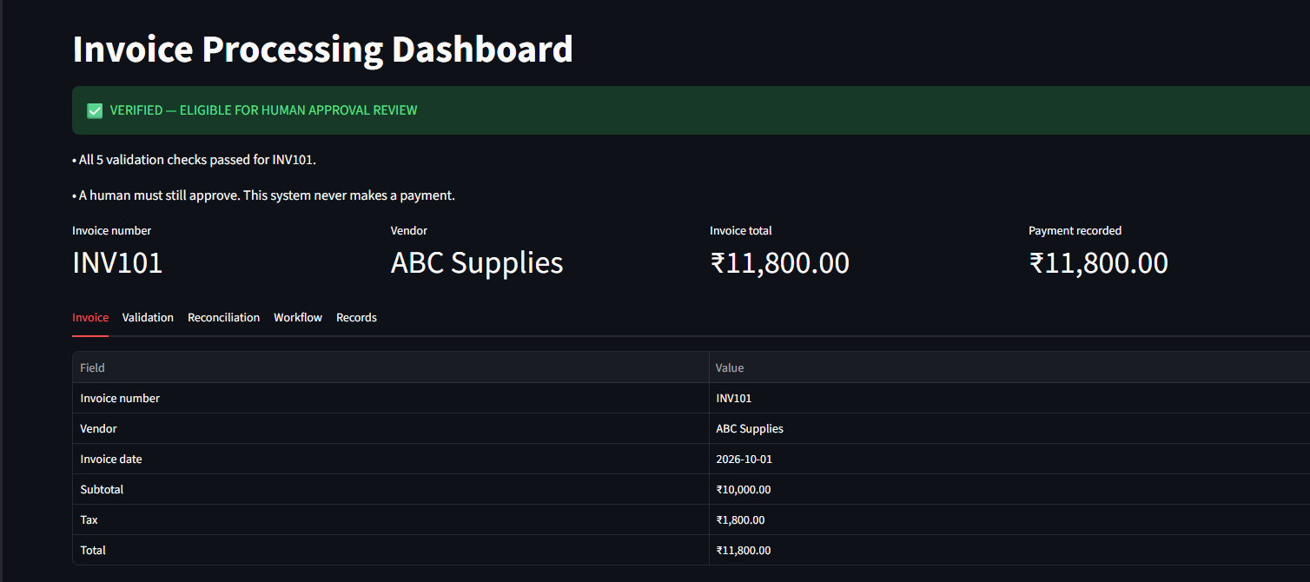
Demo: Process and Read the Result
WHAT TO NOTICE
Green banner: VERIFIED, eligible for human review
Summary shows invoice, vendor, total and payment
Totals match: ₹11,800.00
Invoice tab: the six fields the Document agent extracted.
11

Slide 12
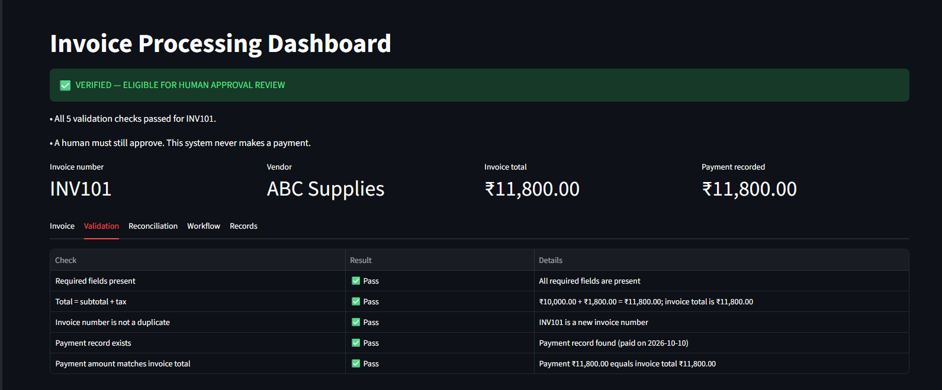
Demo: The 5 Validation Checks
WHAT TO NOTICE
All 5 checks show Pass
Each check explains itself, e.g. ₹10,000 + ₹1,800 = ₹11,800
Payment record found, paid 2026-10-10
Validation tab: every check shows its result and the reason.
12

Slide 13
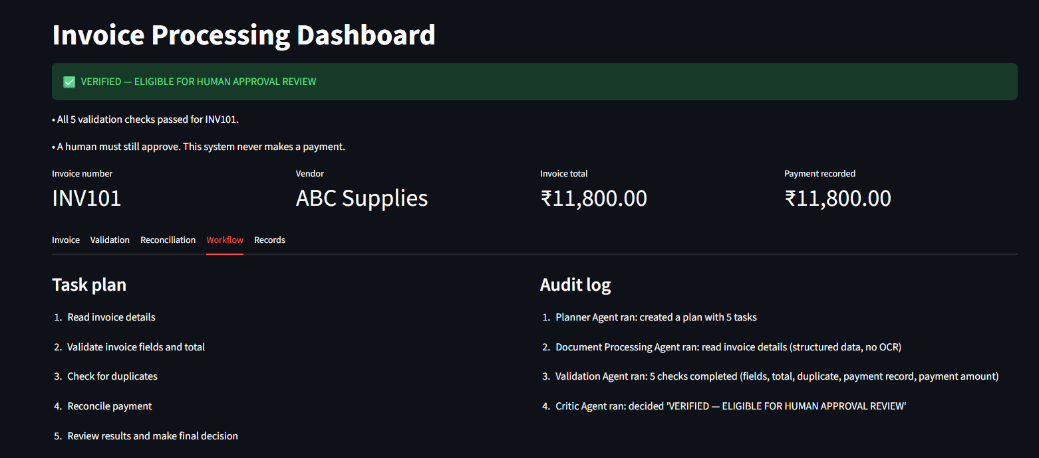
Demo: Workflow and Audit Log
WHAT TO NOTICE
Task plan: the Planner’s 5 steps
Audit log: each agent’s action, in order
Critic’s final decision is recorded
Workflow tab: the plan on the left, what each agent did on the right.
13

Slide 14
Demonstration: Live Scenarios
Invoice | What we select | What the system reports | Status
INV101 | Correct invoice, payment matches | All 5 checks pass; human must still approve | VERIFIED
INV102 | Paid 20,000 vs total 23,600 | Payment mismatch, difference ₹3,600 | FLAGGED
INV103 | Number already in old records | Possible duplicate detected | FLAGGED
INV106 | No payment record exists | Asks for the record; not treated as fraud | INCOMPLETE
Also try: INV104 (wrong total) and INV105 (blank vendor).
14
Notes:
Show INV101 first (green), then INV102, INV103 and INV106 to show the three different outcomes.

Slide 15
Technology & Testing
Technology
Python 3 with plain functions
Streamlit for the dashboard
Decimal for exact money maths
Mermaid for the diagram
Testing (9 tests, all pass)
6 required business cases
Empty input does not crash
Invalid number does not crash
Failed check never VERIFIED
15

Slide 16
Limitations, Future Scope & Conclusion
Limitations
Rule-based, no learning
Structured data, no OCR
Synthetic in-memory records
Future scope
OCR for scanned invoices
LLM-based agents
Real database and bank API
Conclusion: specialised agents cooperating through an orchestrator give clear, explainable invoice decisions, with a human always in control.
16

